Slide 1
Statistical data analysis in R
Visiting professor
Viktor Ermakov

Slide 2
Discreet distributions
Lecture 8

Slide 3
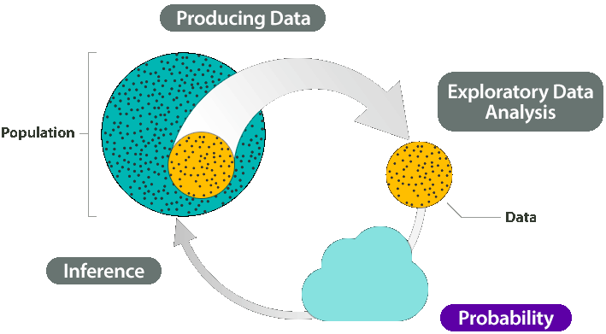
In this lecture
Probability Mass Function and Cumulative Distribution Function
Discrete uniform distribution
Bernoulli distribution
Binomial distribution
Geometric distribution
Negative binomial distribution
Hypergeometric distribution
Poisson distribution
Statistical data analysis in R. Viktor Ermakov – Visiting professor, UFSCar.

Slide 4
Probability Mass Function and Cumulative Distribution Function
Random variable – is a variable whose values depend on outcomes of a random phenomenon.
X – random variable – result of an experiment
x – particular outcome of the experiment
S_{X} = {x₁, x₂}
X=x₁
X=x₂
Statistical data analysis in R. Viktor Ermakov – Visiting professor, UFSCar.

Slide 5
Probability Mass Function and Cumulative Distribution Function
Sample space:
S_{X} = {U₁, U₂, … , U_{k}} – finite number of possible outcomes
or
S_{X} = {U₁, U₂, … } and S_{X} = {…, U_{k,} U_{k+1}, U_{k+2}, … }
– infinite number of possible outcomes
Statistical data analysis in R. Viktor Ermakov – Visiting professor, UFSCar.

Slide 6
Probability Mass Function and Cumulative Distribution Function
Probability Mass Function (PMF)
f_{X}(x) = P(X=x), x ∈ S_{X}
Statistical data analysis in R. Viktor Ermakov – Visiting professor, UFSCar.

Slide 7
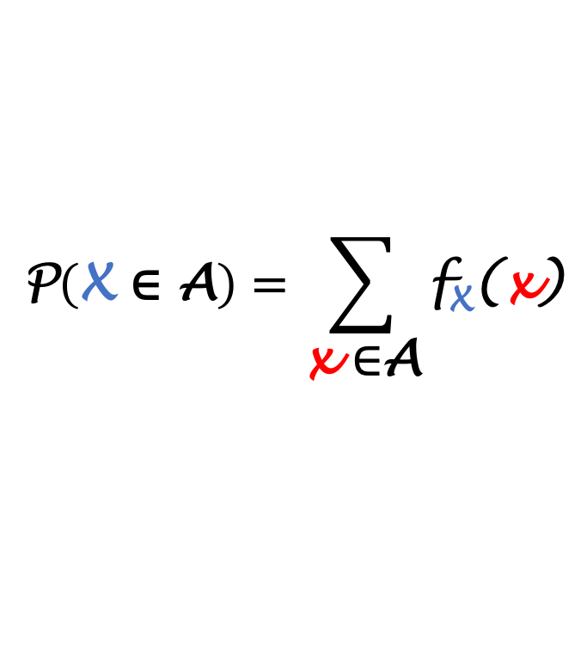
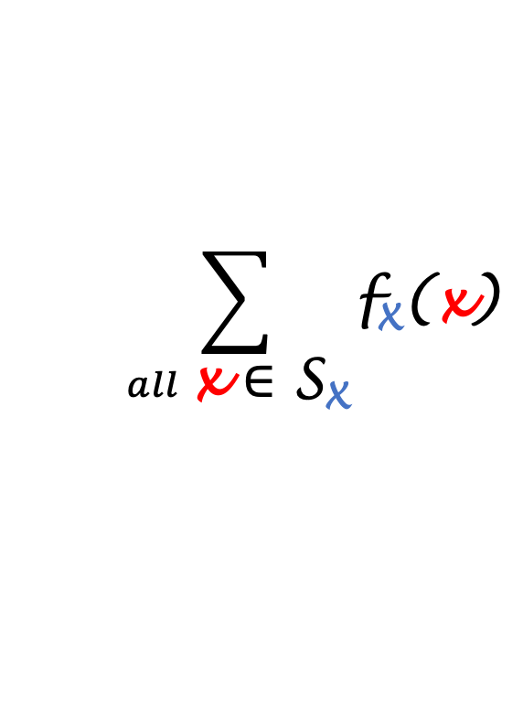
Probability Mass Function and Cumulative Distribution Function
Properties of PMF:
f_{X}(x) > 0 for x ∈ S_{X}
$$\sum_{all \text{x} \text{∈ }\text{S}\text{X}}{\text{f}\text{X}\text{(}\text{x}\text{)}}$$
= 1
$$\text{P}\left(\text{X} \text{∈} \text{A}\right)=\sum_{\text{x} \text{∈}\text{A}}{\text{f}\text{X}\text{(}\text{x}\text{)}}$$
Statistical data analysis in R. Viktor Ermakov – Visiting professor, UFSCar.

Slide 8
Probability Mass Function and Cumulative Distribution Function
Example:
Consider toss a fair coin 3 times
Let’s define a random variable X to be a number of H (Heads)
f_{X}(x)
x
{
0
1
2
3
}
HTT
THT
TTH
HHT
HTH
THH
S =
TTT
HHH
x ∈ S_{X} | 0 | 1 | 2 | 3 | Total
f_{X}(x) = P(X=x) | 1/8 | 3/8 | 3/8 | 1/8 | 1
Statistical data analysis in R. Viktor Ermakov – Visiting professor, UFSCar.

Slide 9
Probability Mass Function and Cumulative Distribution Function
Cumulative Distribution Function (CDF)
F_{X}(t) = P(X≤t), -∞ < t <∞
Statistical data analysis in R. Viktor Ermakov – Visiting professor, UFSCar.

Slide 10
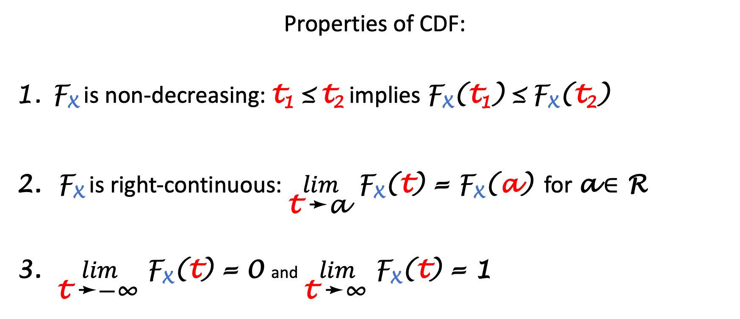
Probability Mass Function and Cumulative Distribution Function
Properties of CDF:
F_{X} is non-decreasing: t₁ ≤ t₂ implies $\text{F}\text{X}\text{(}\text{t}\text{1}\text{)}$ ≤ $\text{F}\text{X}\text{(}\text{t}\text{2}\text{)}$
F_{X} is right-continuous: $\lim_{\text{t} \text{➛}\text{a} }{\text{F}\text{X}\text{(}\text{t}\text{)}}$ = $\text{F}\text{X}\text{(}\text{a}\text{)}$ for a ∈ R
$\lim_{\text{t} \text{➛}\text{−}\text{∞} }{\text{F}\text{X}\text{(}\text{t}\text{)}}$ = 0 and$\lim_{\text{t} \text{➛}\text{∞} }{\text{F}\text{X}\text{(}\text{t}\text{)}}$ = 1
Statistical data analysis in R. Viktor Ermakov – Visiting professor, UFSCar.

Slide 11
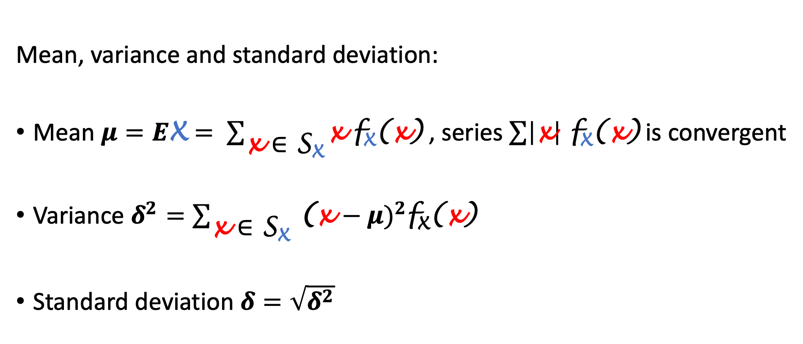
Probability Mass Function and Cumulative Distribution Function
Mean, variance and standard deviation:
Mean $μ=E\text{X}= \sum_{\text{x} \text{∈ }\text{S}\text{X}}{\text{x} \text{f}\text{X}\text{(}\text{x}\text{)}}$ , series $\sum{\left|\text{x}\right| \text{f}\text{X}\text{(}\text{x}\text{)}}$ is convergent
Variance $δ^{2}=\sum_{\text{x} \text{∈ }\text{S}\text{X}}{ {\text{(}\text{x}\text{ −} μ\text{)}}^{2}\text{f}\text{X}\text{(}\text{x}\text{)}}$
Standard deviation $δ=\sqrt{δ^{2}}$
Statistical data analysis in R. Viktor Ermakov – Visiting professor, UFSCar.

Slide 12
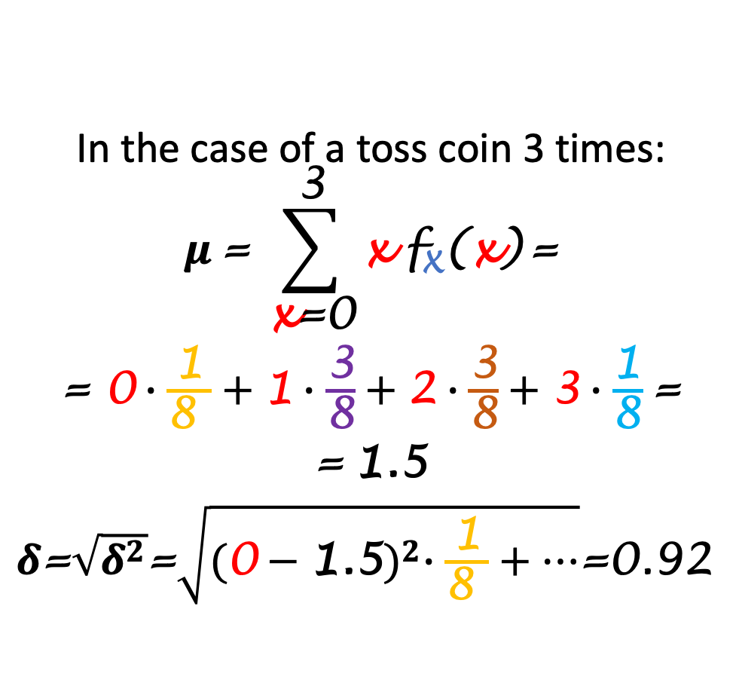
Probability Mass Function and Cumulative Distribution Function
In the case of a toss coin 3 times:
$$μ \text{=} \sum_{\text{x}\text{=0}}^{\text{3}}{\text{x} \text{f}\text{X}\text{(}\text{x}\text{)}}\text{=}$$
$\text{=} \text{0}∙\frac{\text{1}}{\text{8 }}+\text{1}∙\frac{\text{3}}{\text{8}}+\text{2}∙\frac{\text{3}}{\text{8}}+\text{3}∙\frac{\text{1}}{\text{8}}$ $\text{=}$
$\text{=}$1.5
$δ\text{=}\sqrt{δ^{2}}\text{=}\sqrt{{(\text{0}−\text{1.5})}^{2}∙\frac{\text{1}}{\text{8 }}+…}$=0.92
f_{X}(x)
x
{
0
1
1.5
2
3
}
HTT
THT
TTH
HHT
HTH
THH
S =
TTT
HHH
x ∈ S_{X} | 0 | 1 | 2 | 3 | Total
f_{X}(x) = P(X=x) | 1/8 | 3/8 | 3/8 | 1/8 | 1
Statistical data analysis in R. Viktor Ermakov – Visiting professor, UFSCar.

Slide 13
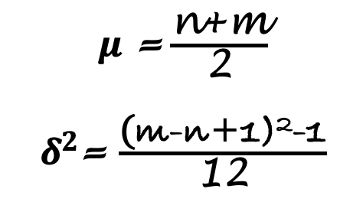
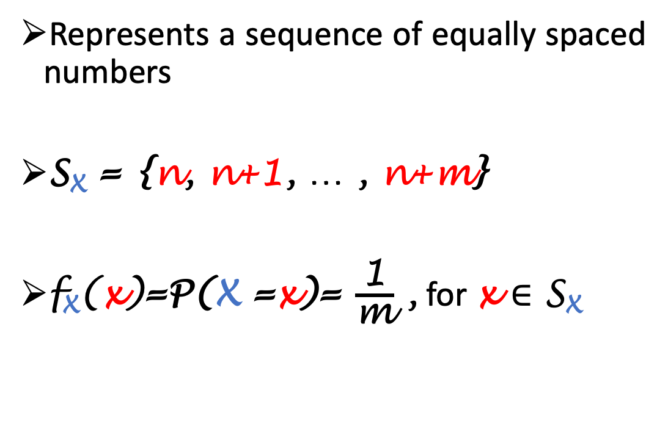
Discrete uniform distribution
f_{X}(x)
Represents a sequence of equally spaced numbers
S_{X} = {n, n+1, … , n+m}
$\text{f}\text{X}\text{(}\text{x}\text{)}\text{=}\text{P}\text{(}\text{X}\text{ =}\text{x}\text{)=} \frac{\text{1}}{\text{m}}$ , for x ∈ S_{X}
x
0
1
2
3
4
5
6
7
8
9
$μ$ =$\frac{\text{n}\text{+}\text{m}}{\text{2}}$
$δ^{2}$= $\frac{\text{(}\text{m}\text{-}\text{n}\text{+1)2-1}}{\text{12}}$
Statistical data analysis in R. Viktor Ermakov – Visiting professor, UFSCar.

Slide 14
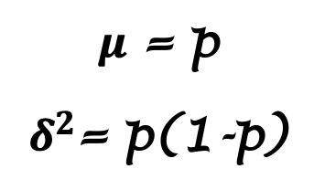
Bernoulli distribution
Describes a result of a single trial that can have two possible outcomes.
Possible outcomes – Success and Faluire
P(S) = p and P(F) = 1-p
X= 1 if S and X= 0 if F
f_{X}(x) =P(X =x)=p^{x}(1-p)^{1-x} for x ∈{0,1}
p=0.7
f_{X}(x)
p
1-p
x
0
1
$μ$ = p
$δ^{2}$= p(1-p)
Statistical data analysis in R. Viktor Ermakov – Visiting professor, UFSCar.

Slide 15
Bernoulli distribution
Some other discreet distributions are built on the assumption of independent Bernoulli trials. They are all distributions of:
Binomial
number of successes in n independent trials
Geometric
number of trials to get the first success
Negative Binomial
number of trials to get the r-th success
Hypergeometric
sampling n objects without replacement from a source that contains a successes and N-a failures.
p=0.7
f_{X}(x)
p
1-p
x
0
1
Statistical data analysis in R. Viktor Ermakov – Visiting professor, UFSCar.

Slide 16
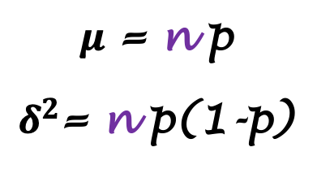
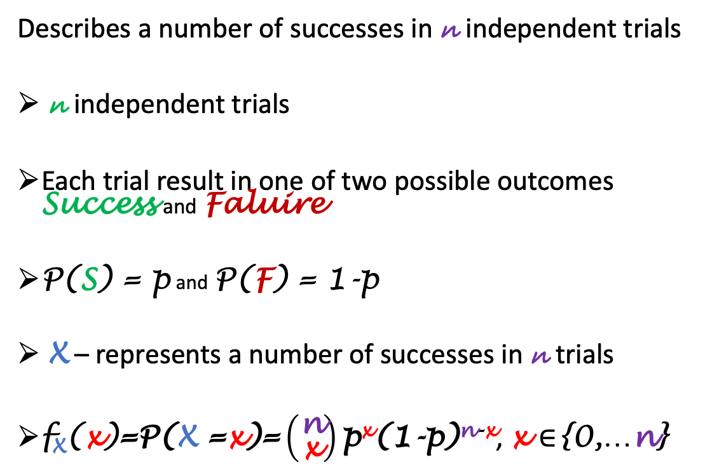
Binomial distribution
Describes a number of successes in n independent trials
n independent trials
Each trial result in one of two possible outcomes Success and Faluire
P(S) = p and P(F) = 1-p
X – represents a number of successes in n trials
$\text{f}\text{X}\text{(}\text{x}\text{)}\text{=}\text{P}\text{(}\text{X}\text{ =}\text{x}\text{)=}\left({\text{n} \atop \text{x}}\right)\text{p}\text{x}\text{(1-}\text{p}\text{)}\text{n}\text{-}\text{x}$, x ∈{0,…n}
f_{X}(x)
n=10
p=0.3
x
0
1
2
3
4
5
6
7
8
9
$μ$ = n p
$δ^{2}$= n p(1-p)
Statistical data analysis in R. Viktor Ermakov – Visiting professor, UFSCar.

Slide 17
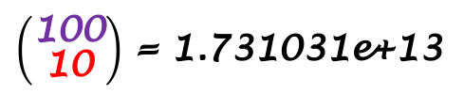
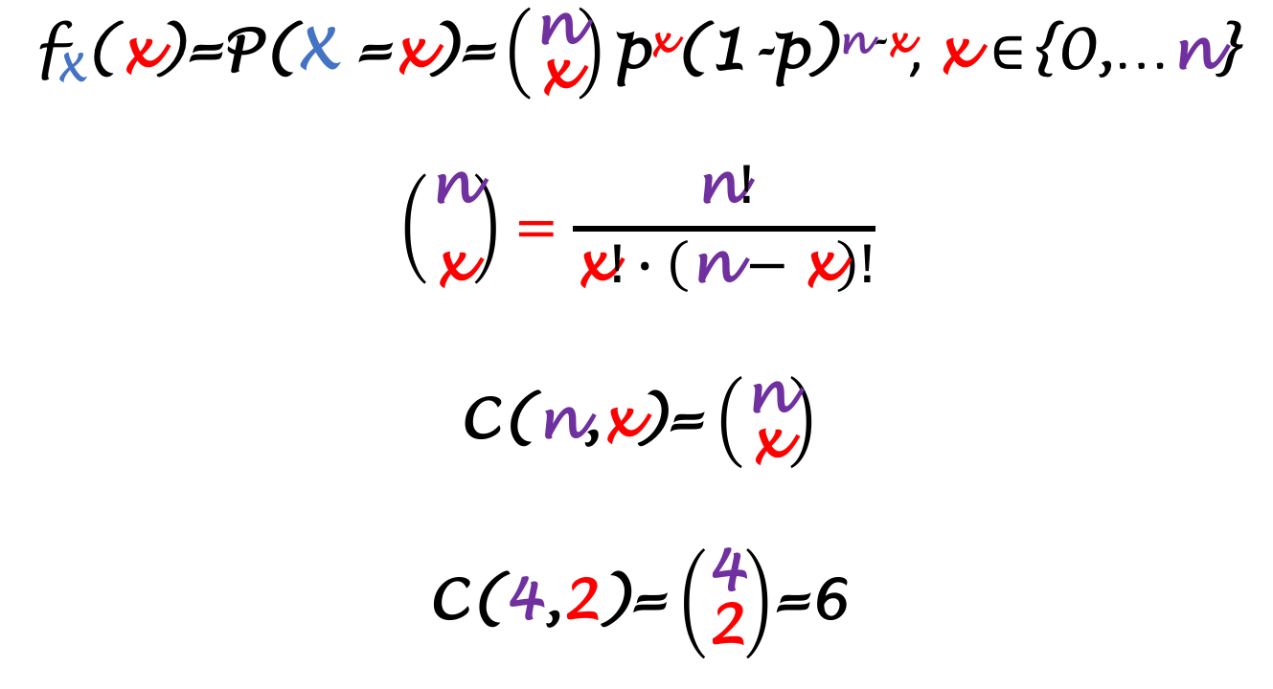
Binomial distribution
{1,2,3,4}
{1,2} or {2,1}
{1,3} or {3,1}
{1,4} or {4,1}
{2,3} or {3,2}
{2,4} or {4,2}
{3,4} or {4,3}
$\text{f}\text{X}\text{(}\text{x}\text{)}\text{=}\text{P}\text{(}\text{X}\text{ =}\text{x}\text{)=}\left({\text{n} \atop \text{x}}\right)\text{p}\text{x}\text{(1-}\text{p}\text{)}\text{n}\text{-}\text{x}$, x ∈{0,…n}
$$\left({\text{n} \atop \text{x}}\right)=\frac{\text{n}!}{\text{x}!∙\left(\text{n}−\text{x}\right)!}$$
C(n,x)= $\left({\text{n} \atop \text{x}}\right)$
C(4,2)= $\left({\text{4} \atop \text{2}}\right)$=6
$\left({\text{100} \atop \text{10}}\right)$ = 1.731031e+13
Statistical data analysis in R. Viktor Ermakov – Visiting professor, UFSCar.

Slide 18
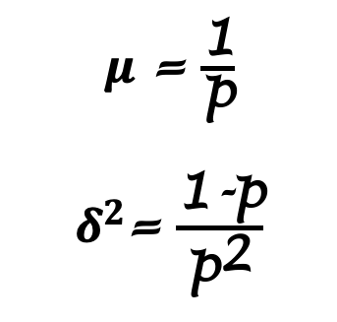
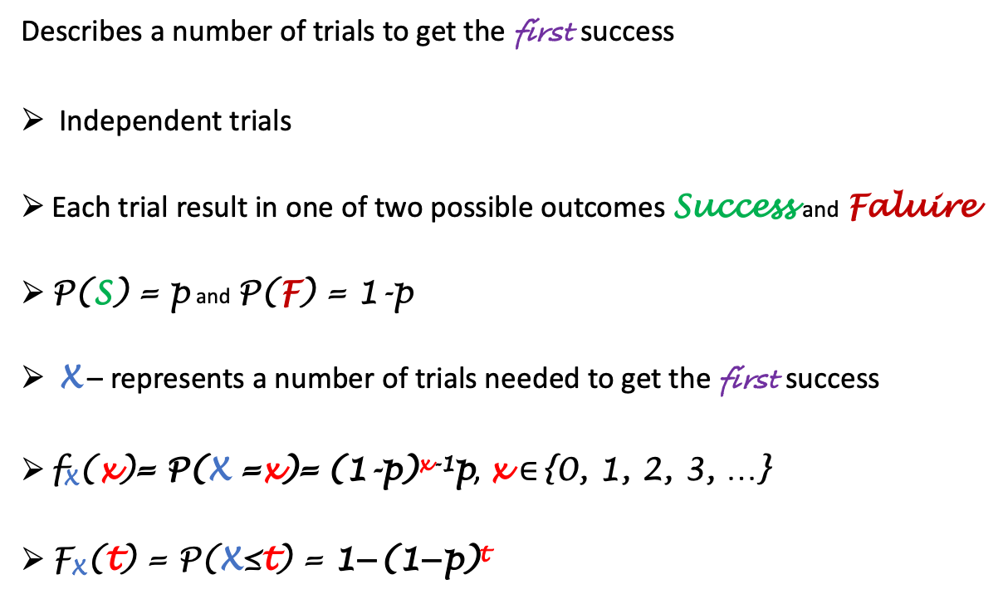
Geometric distribution
f_{X}(x)
Describes a number of trials to get the first success
Independent trials
Each trial result in one of two possible outcomes Success and Faluire
P(S) = p and P(F) = 1-p
X – represents a number of trials needed to get the first success
$\text{f}\text{X}\text{(}\text{x}\text{)}\text{= }\text{P}\text{(}\text{X}\text{ =}\text{x}\text{)=} \text{(1-}\text{p}\text{)}\text{x}\text{-1}\text{p}$, x ∈{0, 1, 2, 3, …}
F_{X}(t) = P(X≤t) = $\text{1−(1−}\text{p}\text{)}\text{t}$
p=0.3
x
0
1
2
3
4
5
6
7
8
9
$μ$ = $\frac{\text{1}}{\text{p}}$
$δ^{2}$= $\frac{\text{1}\text{-}\text{p}}{{\text{p}}^{\text{2}}}$
Statistical data analysis in R. Viktor Ermakov – Visiting professor, UFSCar.

Slide 19
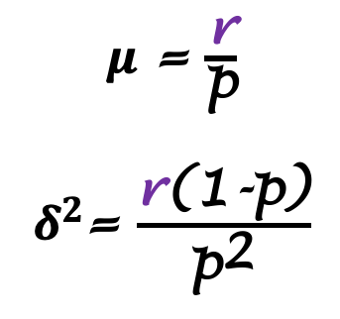
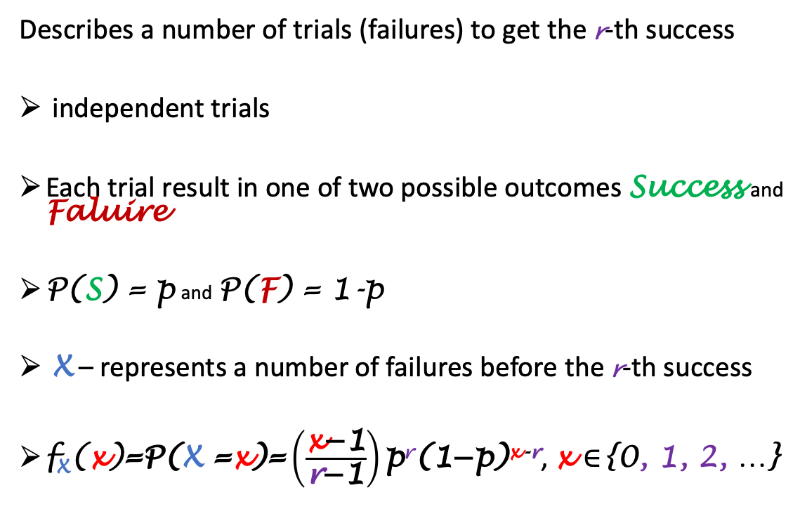
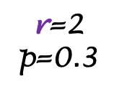
Negative Binomial distribution
Describes a number of trials (failures) to get the r-th success
independent trials
Each trial result in one of two possible outcomes Success and Faluire
P(S) = p and P(F) = 1-p
X – represents a number of failures before the r-th success
$\text{f}\text{X}\text{(}\text{x}\text{)}\text{=}\text{P}\text{(}\text{X}\text{ =}\text{x}\text{)=}\left(\frac{\text{x}\text{−1}}{\text{r}\text{−1}}\right)\text{p}\text{r}\text{(1−}\text{p}\text{)}\text{x}\text{-}\text{r}$, x ∈{0, 1, 2, …}
f_{X}(x)
$\text{r}$=2
p=0.3
x
0
1
2
3
4
5
6
7
8
9
$μ$ = $\frac{\text{r}}{\text{p}}$
$δ^{2}$= $\frac{\text{r}\text{(}\text{1}\text{-}\text{p}\text{)}}{{\text{p}}^{\text{2}}}$
Statistical data analysis in R. Viktor Ermakov – Visiting professor, UFSCar.

Slide 20
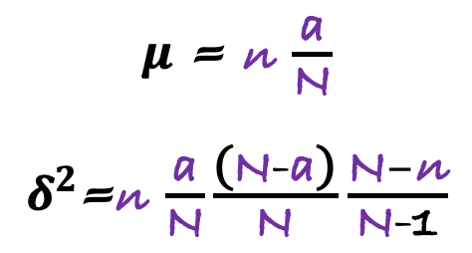
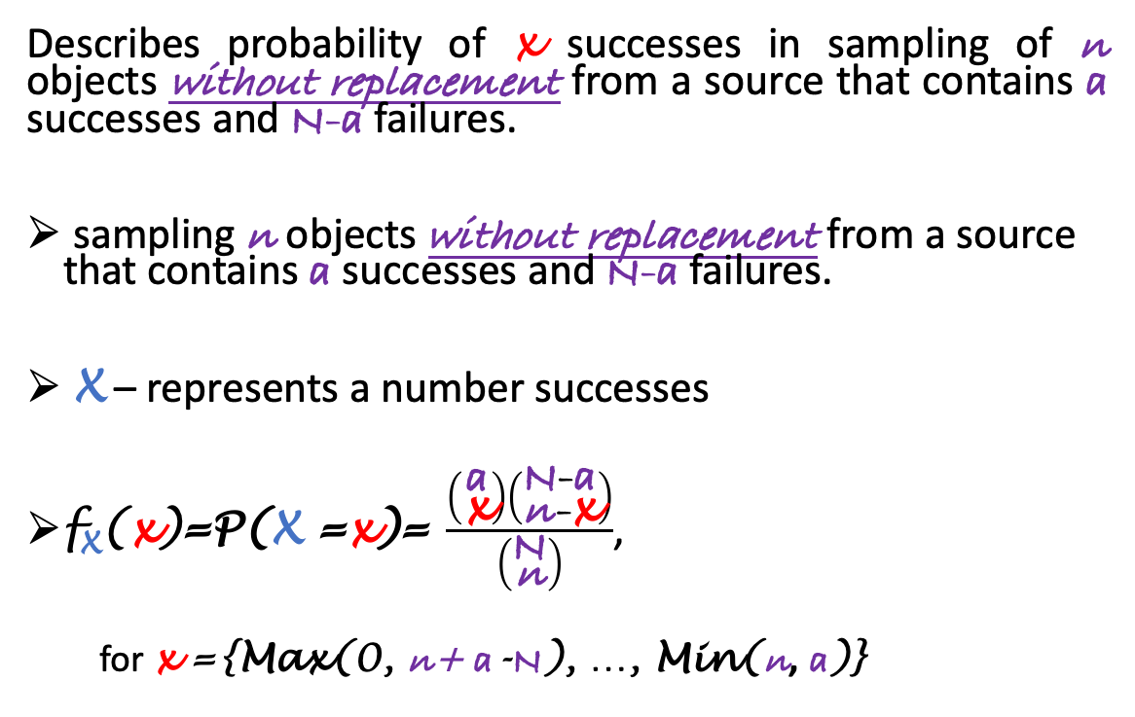
Hypergeometric distribution
Describes probability of x successes in sampling of n objects without replacement from a source that contains a successes and N-a failures.
sampling n objects without replacement from a source that contains a successes and N-a failures.
X – represents a number successes
$\text{f}\text{X}\text{(}\text{x}\text{)}\text{=}\text{P}\text{(}\text{X}\text{ =}\text{x}\text{)=} \frac{\left({\text{a} \atop \text{x}}\right)\left({\text{N}\text{-}\text{a} \atop \text{n}\text{-}\text{x}}\right)}{\left({\text{N} \atop \text{n}}\right)}$,
for x ={Max(0, n+ a-$\text{N}$), …, Min(n, a)}
f_{X}(x)
N=15
a =10
n =10
x
0
1
2
3
4
5
6
7
8
9
$μ$ = $\text{n} \frac{\text{a}}{\text{N}}$
$δ^{2}$=$\text{n} \frac{\text{a}}{\text{N}}\frac{\text{(}\text{N}\text{-}\text{a}\text{)}}{\text{N}}$ $\frac{\text{N}−\text{n}}{\text{N}\text{-1}}$
Statistical data analysis in R. Viktor Ermakov – Visiting professor, UFSCar.

Slide 21
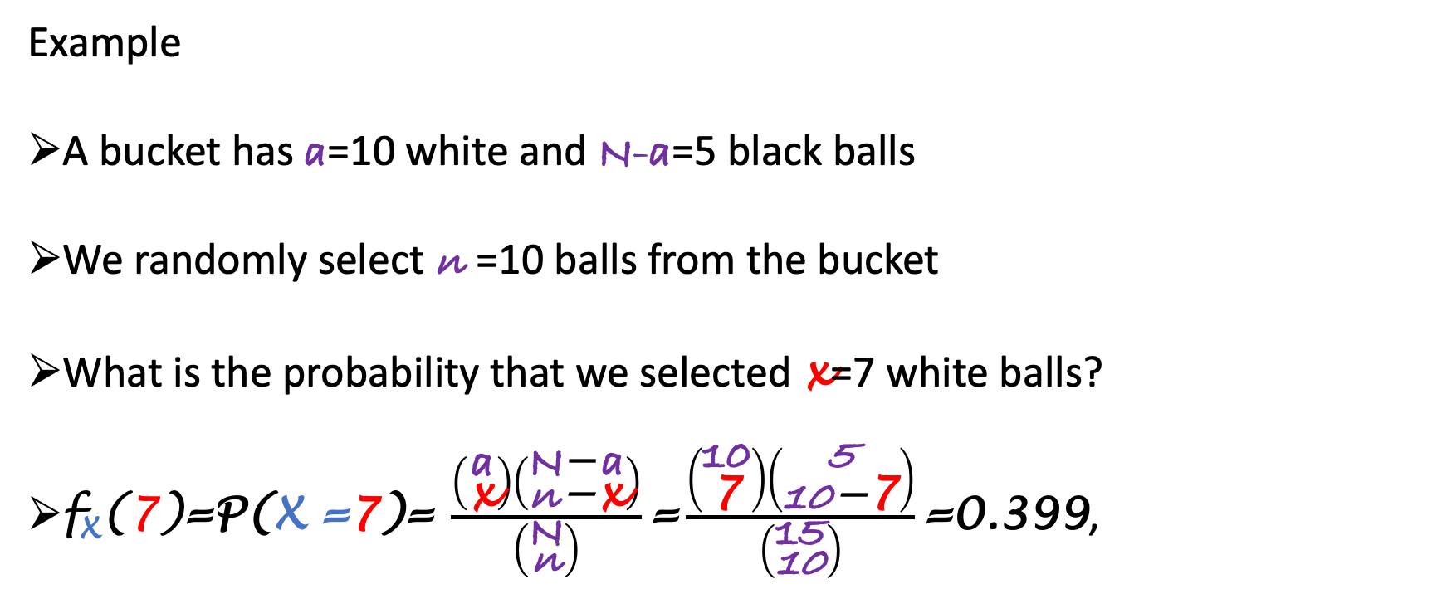
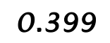
Hypergeometric distribution
f_{X}(x)
$$\text{0.399}$$
Example
A bucket has a=10 white and N-a=5 black balls
We randomly select n =10 balls from the bucket
What is the probability that we selected x=7 white balls?
$\text{f}\text{X}\text{(}\text{7}\text{)}\text{=}\text{P}\text{(}\text{X}\text{ =7)}\text{=} \frac{\left({\text{a} \atop \text{x}}\right)\left({\text{N}\text{−}\text{a} \atop \text{n}\text{−}\text{x}}\right)}{\left({\text{N} \atop \text{n}}\right)}\text{=}\frac{\left({\text{10} \atop \text{7}}\right)\left({\text{5} \atop \text{10}\text{−}\text{7}}\right)}{\left({\text{15} \atop \text{10}}\right)}\text{=}\text{0.399}$,
N=15
a =10
n =10
x
0
1
2
3
4
5
6
7
8
9
Statistical data analysis in R. Viktor Ermakov – Visiting professor, UFSCar.

Slide 22
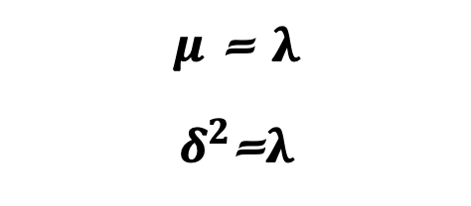
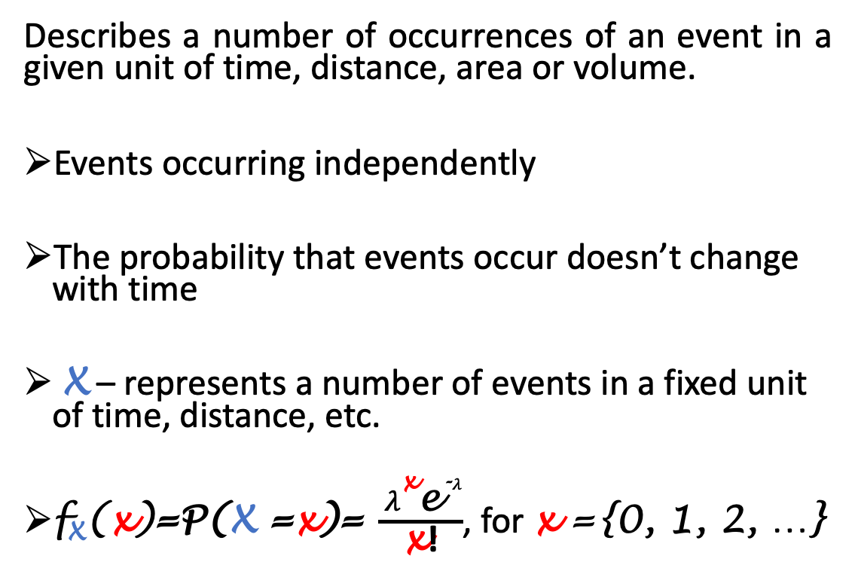
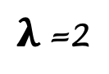
Poisson distribution
Describes a number of occurrences of an event in a given unit of time, distance, area or volume.
Events occurring independently
The probability that events occur doesn’t change with time
X – represents a number of events in a fixed unit of time, distance, etc.
$\text{f}\text{X}\text{(}\text{x}\text{)}\text{=}\text{P}\text{(}\text{X}\text{ =}\text{x}\text{)=} \frac{ λ^{\text{x}}{\text{e}}^{\text{-}λ}}{\text{x}\text{!}}$, for x ={0, 1, 2, …}
f_{X}(x)
$λ$=2
x
0
1
2
3
4
5
6
7
8
9
$μ$ = $λ$
$δ^{2}$=$λ$
Statistical data analysis in R. Viktor Ermakov – Visiting professor, UFSCar.

